Slide 1
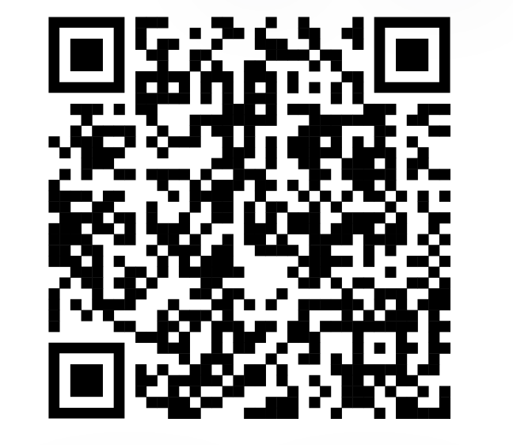
General Body Meeting #1
January 23rd, 2024
Sign In Here:
Notes:
Press F11 for Fullscreen, then Ctrl+F5 to Start Presentation

Slide 2
Ice Breaker:

Slide 3
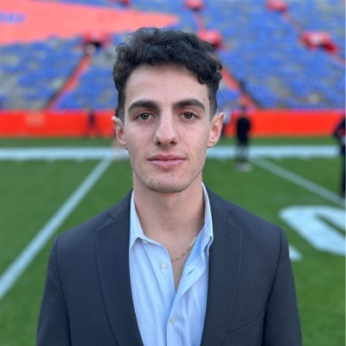
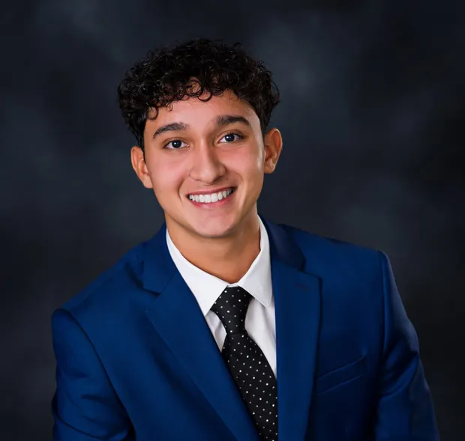
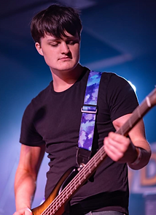
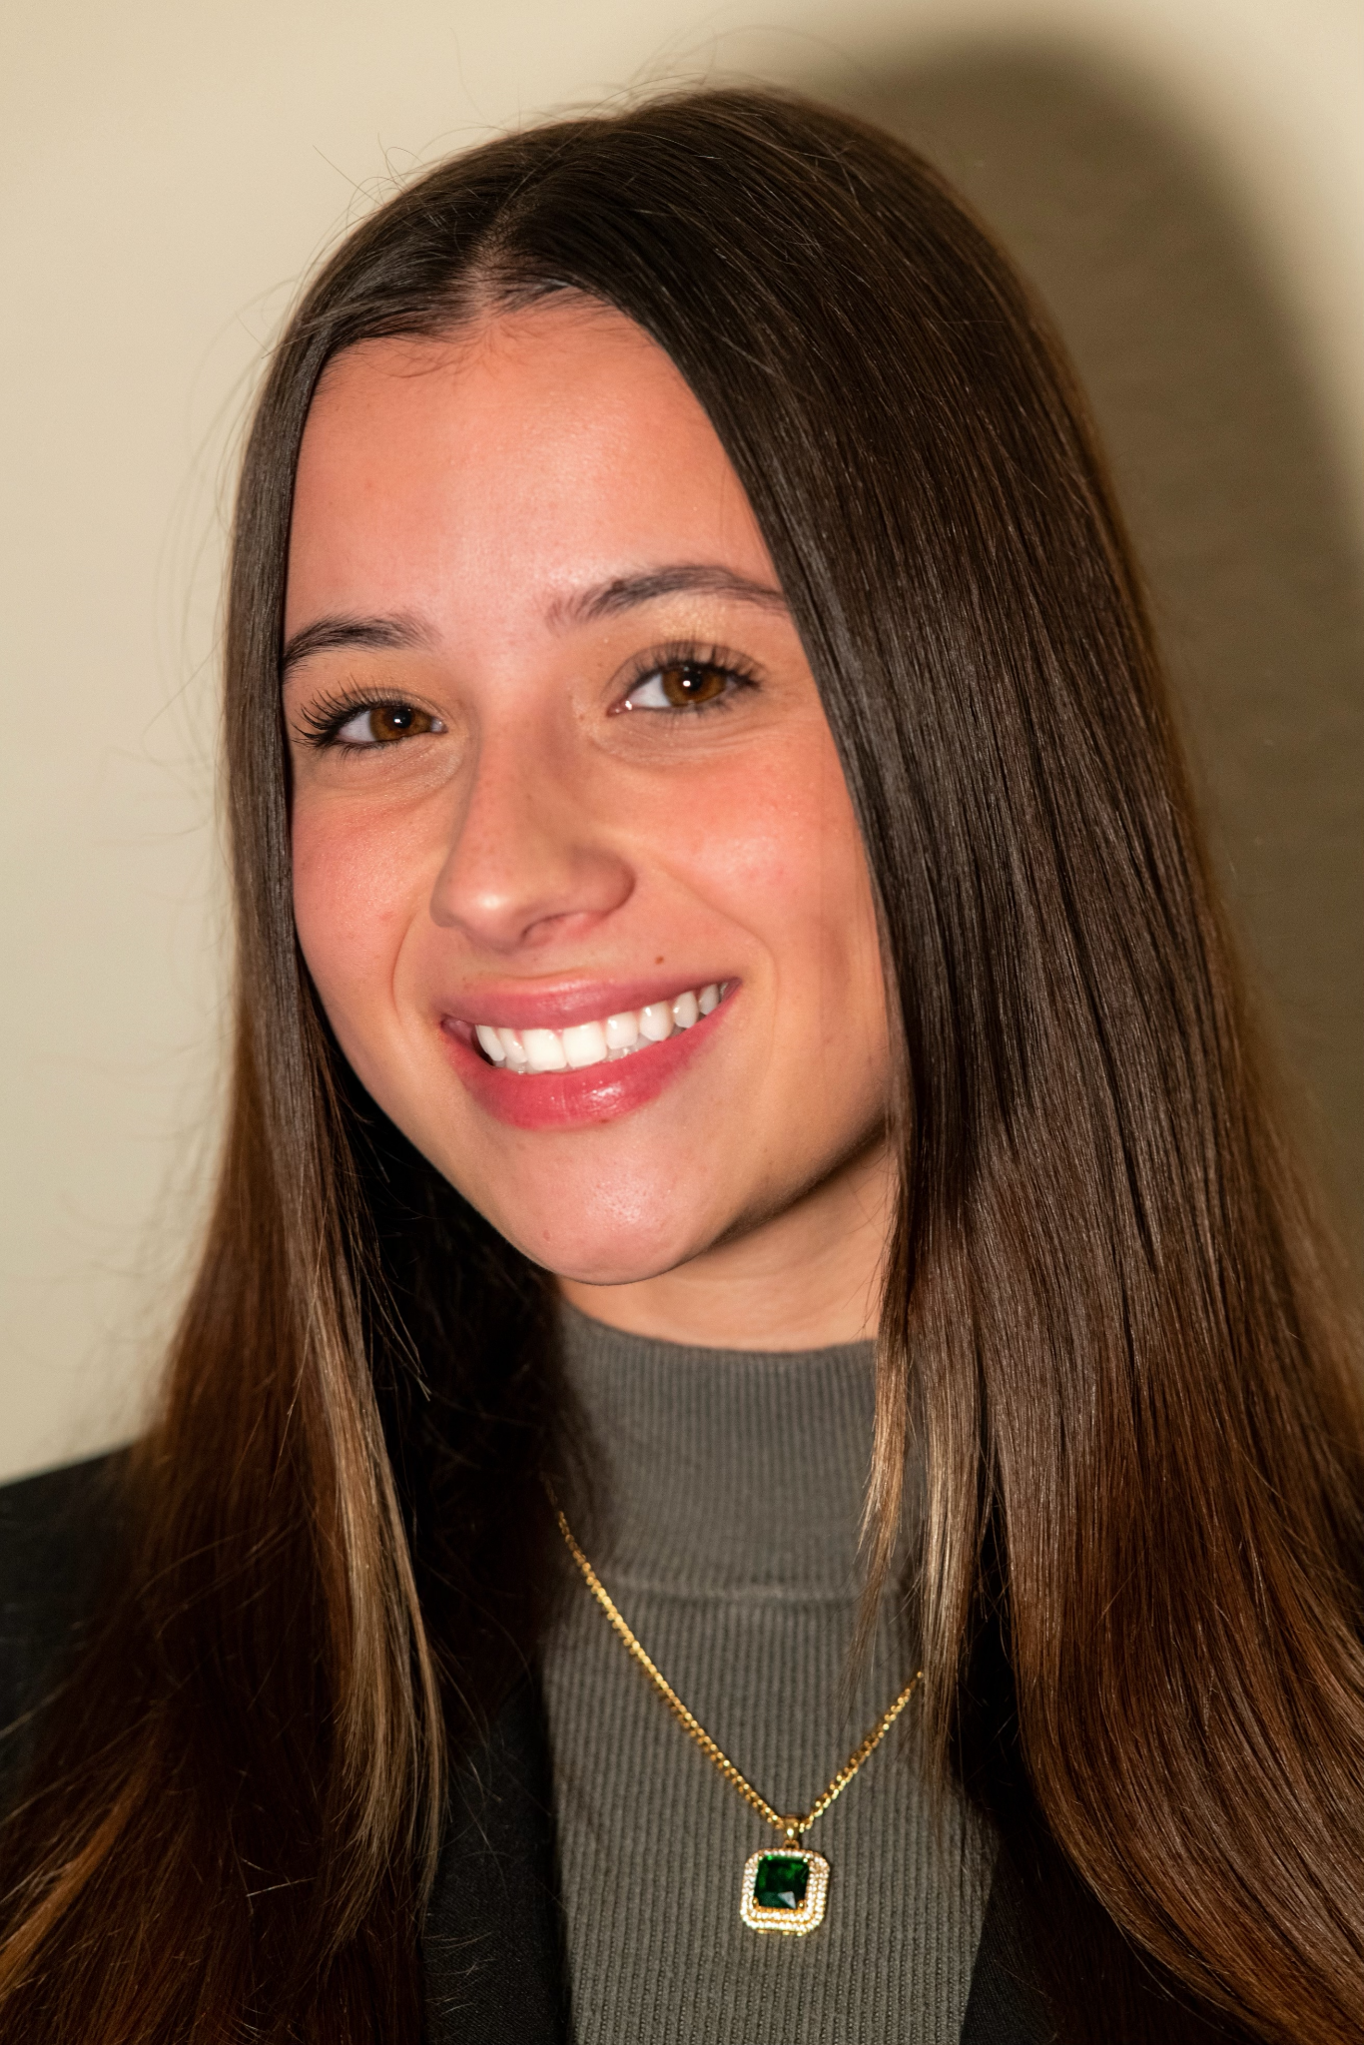
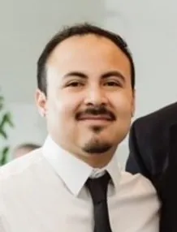
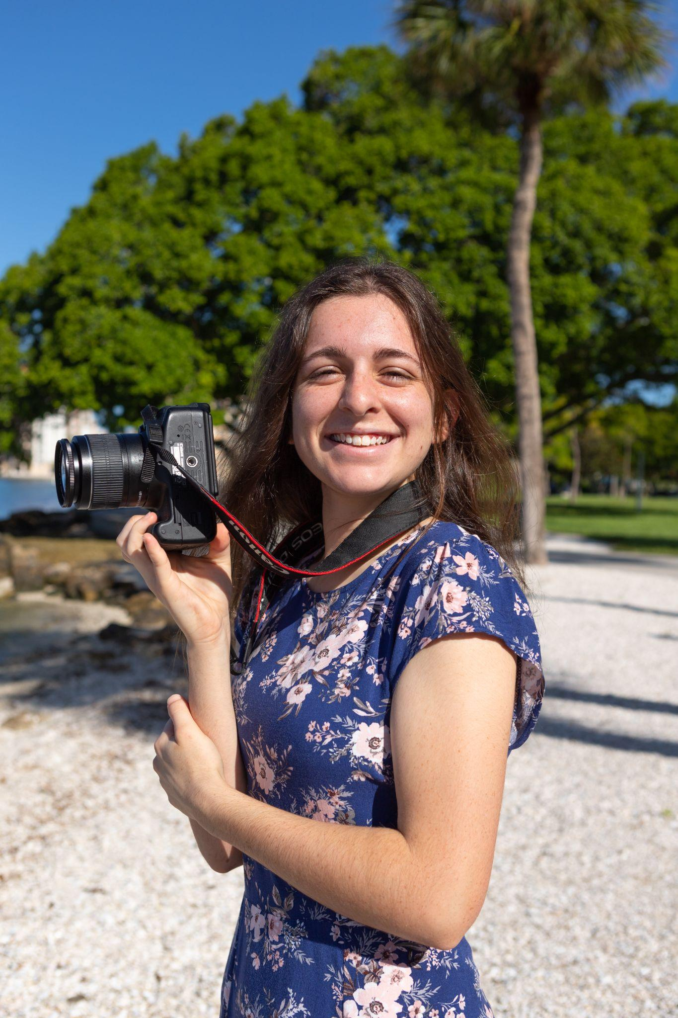
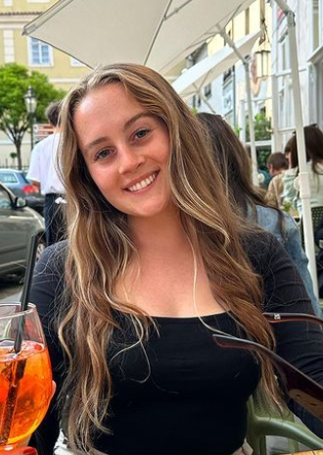
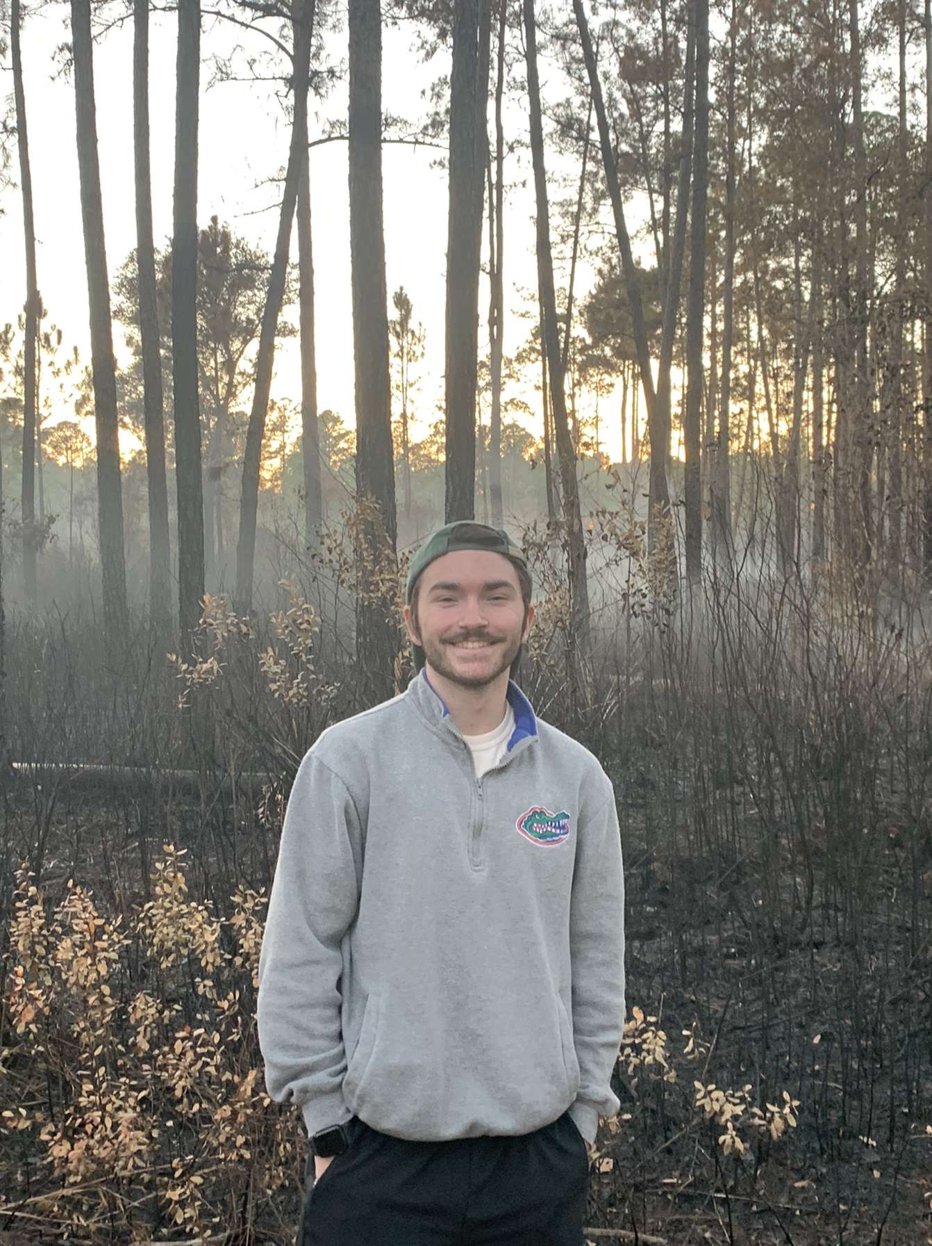
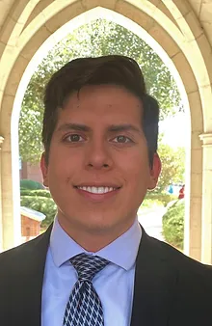
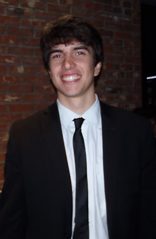
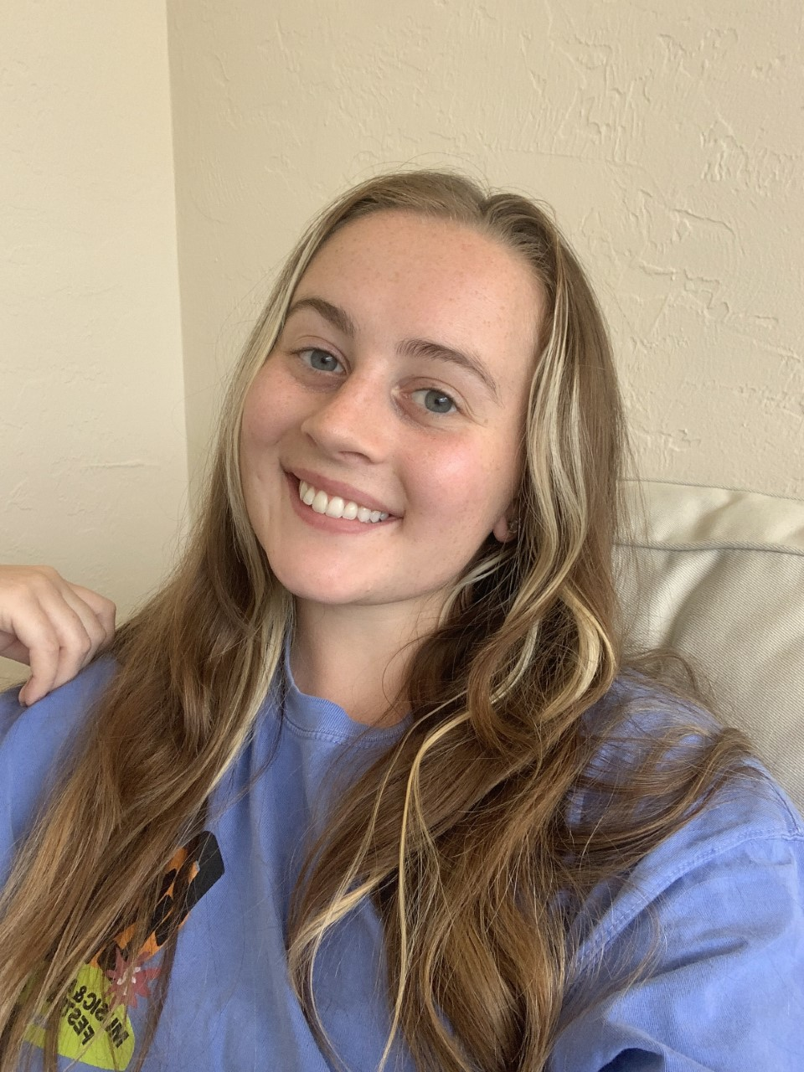
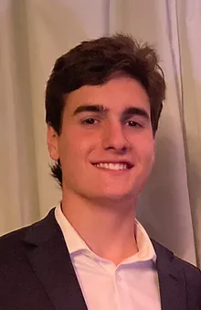
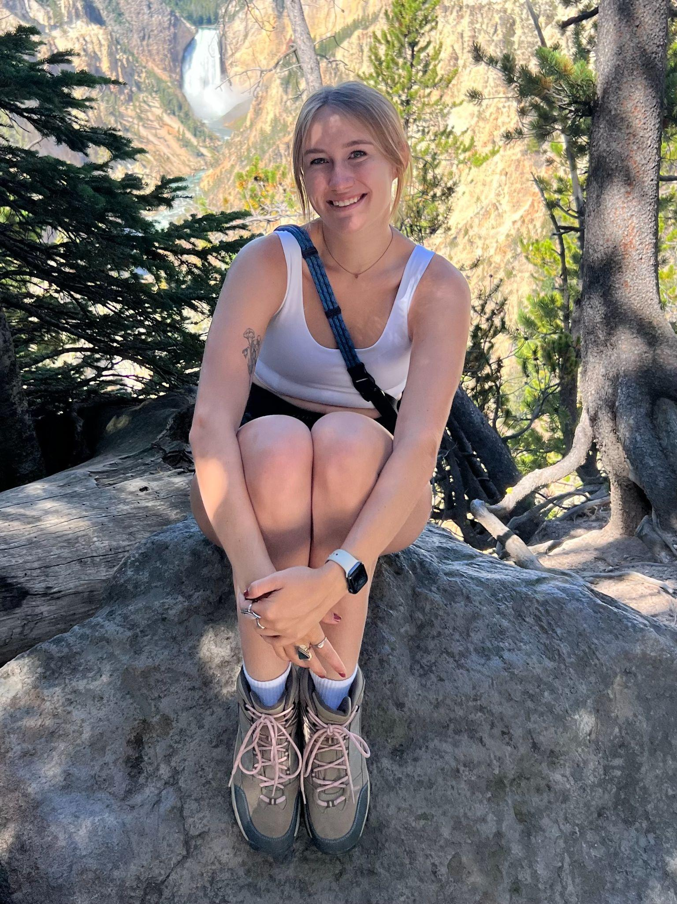
Officers
President
Aaron Fintz
Vice President
of Administration
Vishnu Malhotra
Vice President of Builds
Nathaniel Fuller
Secretary
Chloe Venter
Graduate Ambassador
Anthony Rodriguez Pesci
Event Coordinator
Jordyn Chiodo
Fundraising Chair
Ryan Mulhall
Social Chair
Adelle Mitchell
Public Relations Co-Chair
Routledge Harris
Undergraduate
Ambassador
Austin Anderson
Public Relations Co-Chair
Derek Molina
Treasurer
Kyla Hoffbauer
Web Developer
Spencer Farfante

Slide 4
Member of the Month!
Congratulations to
Heather Reid!
Come see us after for a free merch item!

Slide 5
4 Pillars of Habitat
Bui ld
Fundraise
Advoca te
Educa te
Notes:
Building: we build and rehabilitate homes in partnership with Habitat homeowners locally, nationally, and internationally
Fundraising: we raise money to support the growth and development of Habitat for Humanity
Advocacy involves increasing awareness and influencing housing policy
Education: involves educating others on our campus and in our local community about the impact of homeownership and the need for decent, safe, and affordable housing

Slide 6
Active Membership
Requirements for Active Membership each Semester
Minimum 2 GBMs
1 Fundraiser
Any 2 Additional Activity Below
(Builds, Events, Socials, Fundraisers)
Perks of active membership:
Vote and run for e-board!
Free Habitat Swag
Letter of Recommendation upon request
As you earn active membership throughout the semester, come pick up your Habitat merchandise from us!

Slide 7
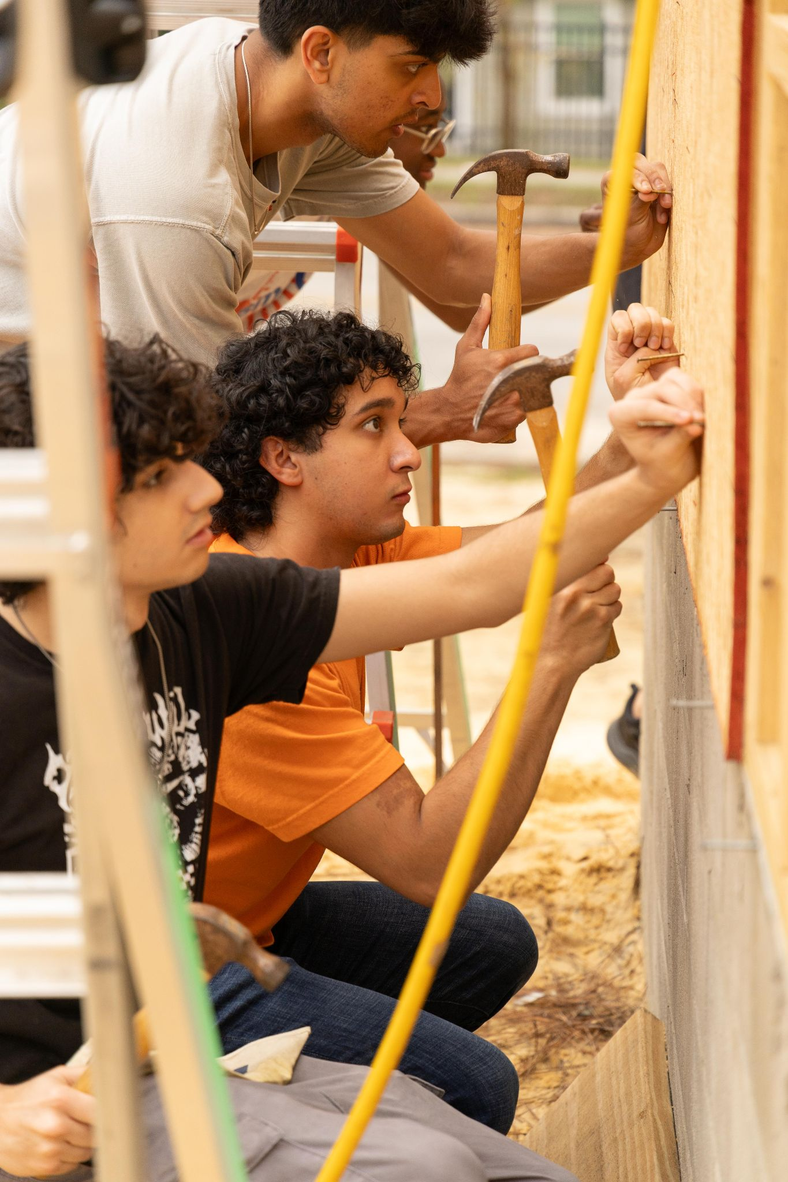
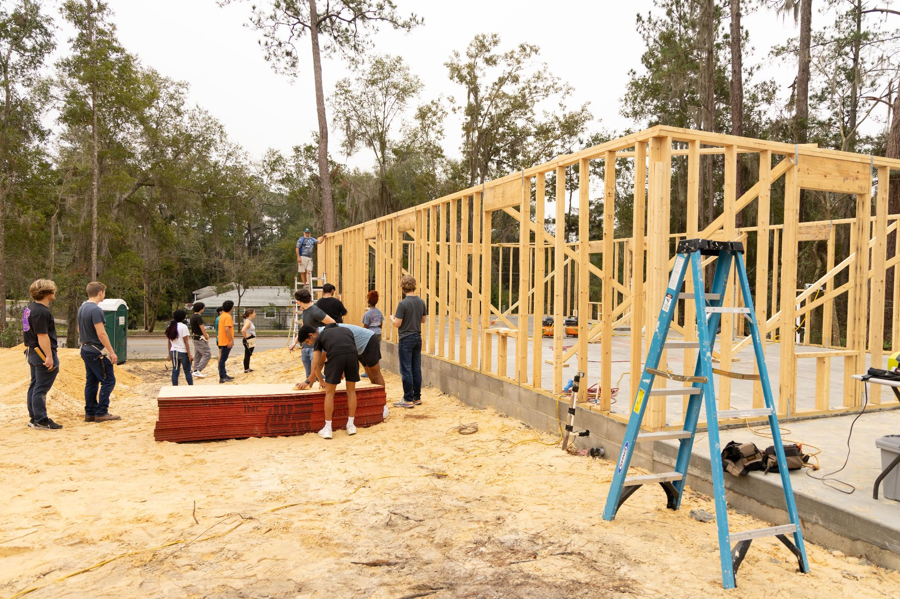
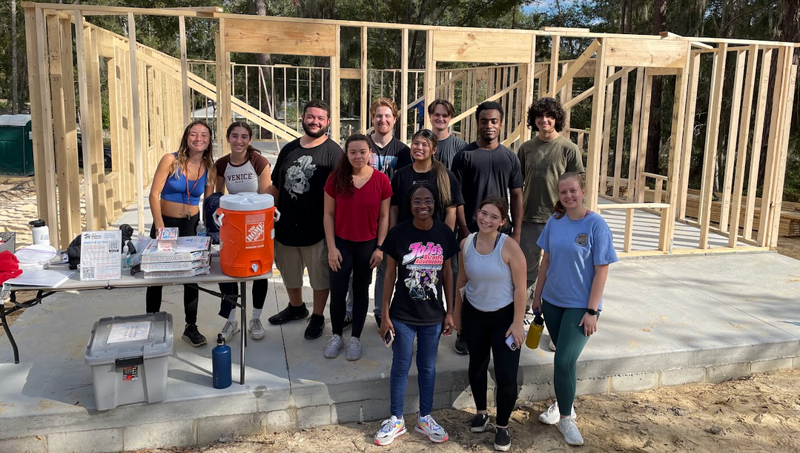
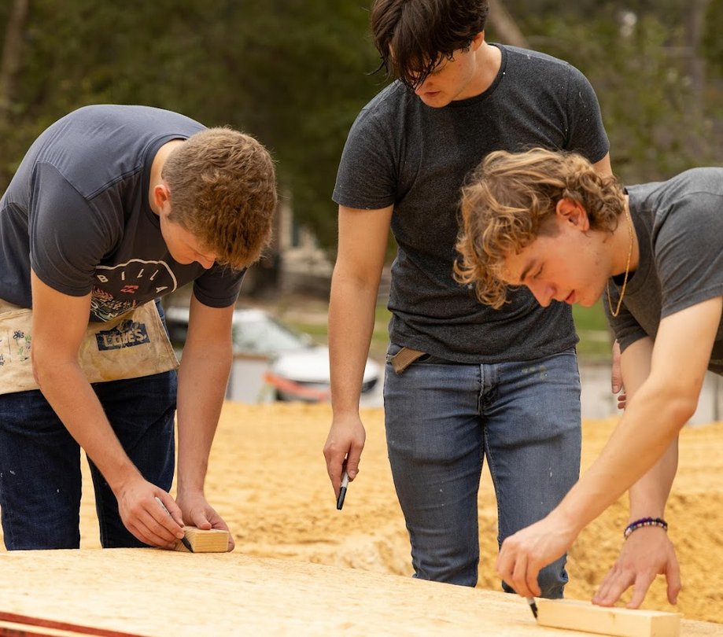
Builds
Build Information:
Saturdays 8:30am - 2:30pm
No experience needed
Water, snacks, and lunch is provided
Sunscreen, towels, and supplies provided
Wear clothing that you don't mind getting
dirty and closed toe shoes
Build Sign up:
https://tinyurl.com/ufhabitatvolunteerhub
Be sure to make an account first
3 no shows without notice=
no more builds :(((

Slide 8
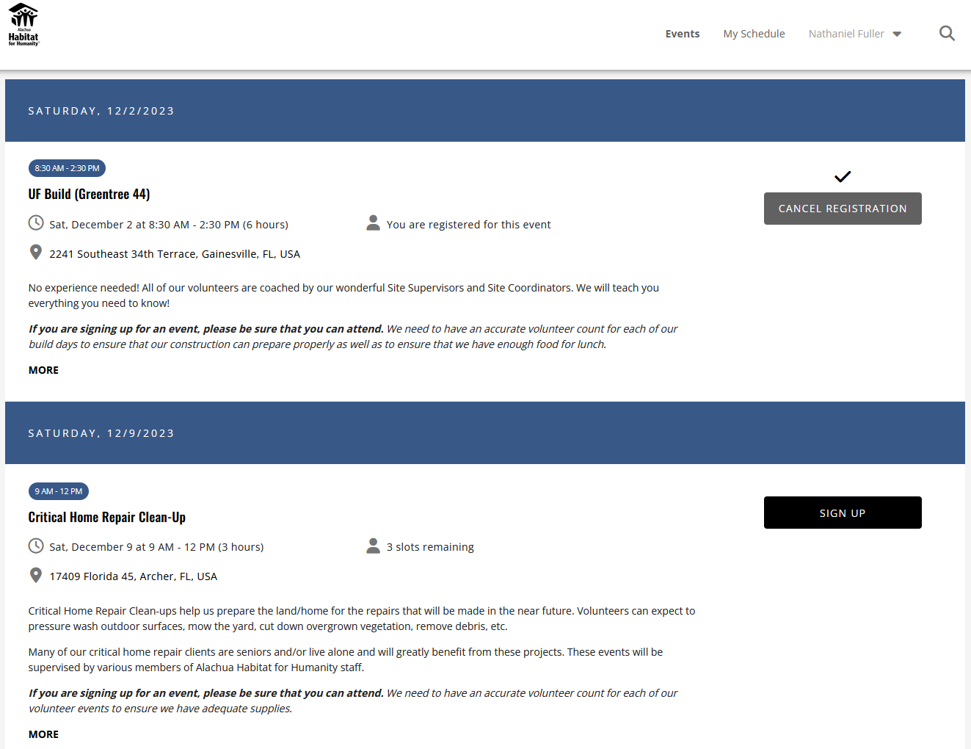
More Builds Info
UF Builds
Saturdays 8:30-2:30 pm
2241 Southeast 34th Terrace
Sign up deadline for UF builds -> Wednesday before build
Fill out the carpool for by Wednesday 11:59PM
Other opportunities sometimes pop up on volunteerhub when other organizations flake last minute. We’ll keep you up to date on these through GroupMe

Slide 9
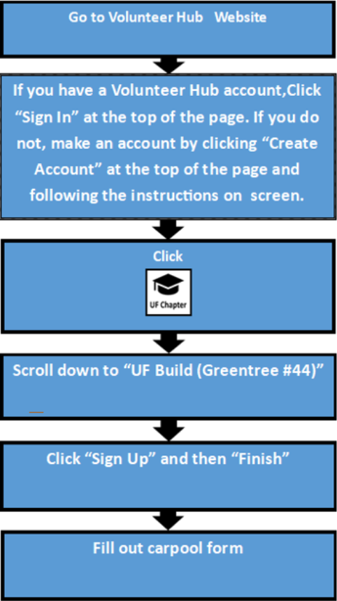
Steps to Sign up for a Build
Current build address:
2241 Southeast 34th Terrace, Gainesville, FL
Sign up link:
https://tinyurl.com/ufhabitatvolunteerhub
https://forms.gle/UoMmQbmN5h9AZ7qaA

Slide 10
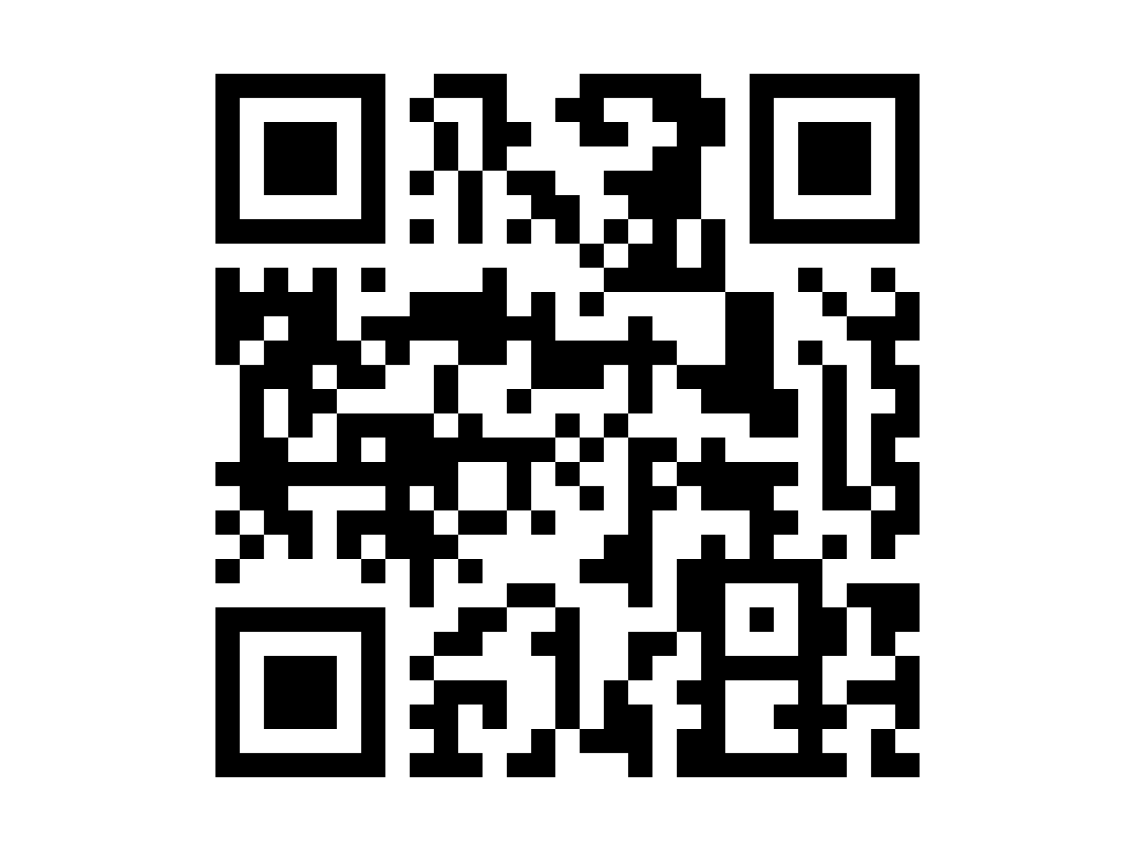
Events
Food Truck Rally
January 27th @ 4 p.m. at High Dive
FREE entry, parking, and live music
Vegan and vegetarian options available
Chances to win prizes from Raising Cane’s, Hyppo Popsicles, and more!
More Details Here

Slide 11
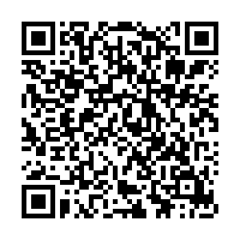
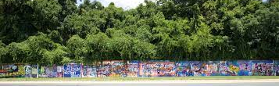
Socials
Social: 34th St Wall Painting
Where: Meet in PDQ parking lot
When: TOMORROW Wednesday, 1/24
Time: 5:30 pm
Help us promote
the Food Truck Rally!

Slide 12
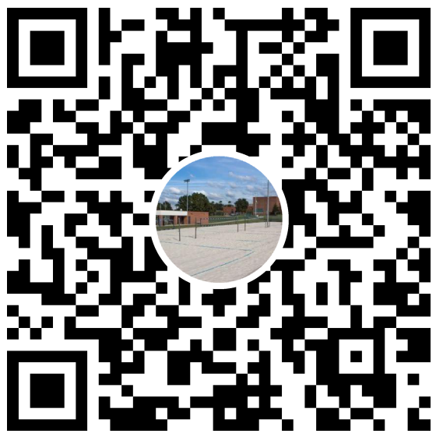
Intramurals
Beach Volleyball
Where: UVS Courts
(sand courts by SW Rec)
When: Mondays @ 7pm
Join Groupme through QR

Slide 13
Fundraisers
Thank you everyone who came to our
last fundraiser at Chipotle!!
Bento Fundraiser on February 28, 2024
Where: 150 NW 13th (Under The Standard)
When: All day, come at any time
Officers will choose a time where we
will all be there
Mention Habitat at Checkout!
Stay tuned in the GroupMe
for upcoming fundraisers

Slide 14
Thanks for coming!
Next meeting: ------> February (TBA)
-keep an eye out on our social medias and GroupMe for more information
UF Habitat for Humanity 2023-2024
@ufh4h
www.ufhabitat.org
https://groupme.com/join_group/63334765/XaNWwHQg

